Slide 1
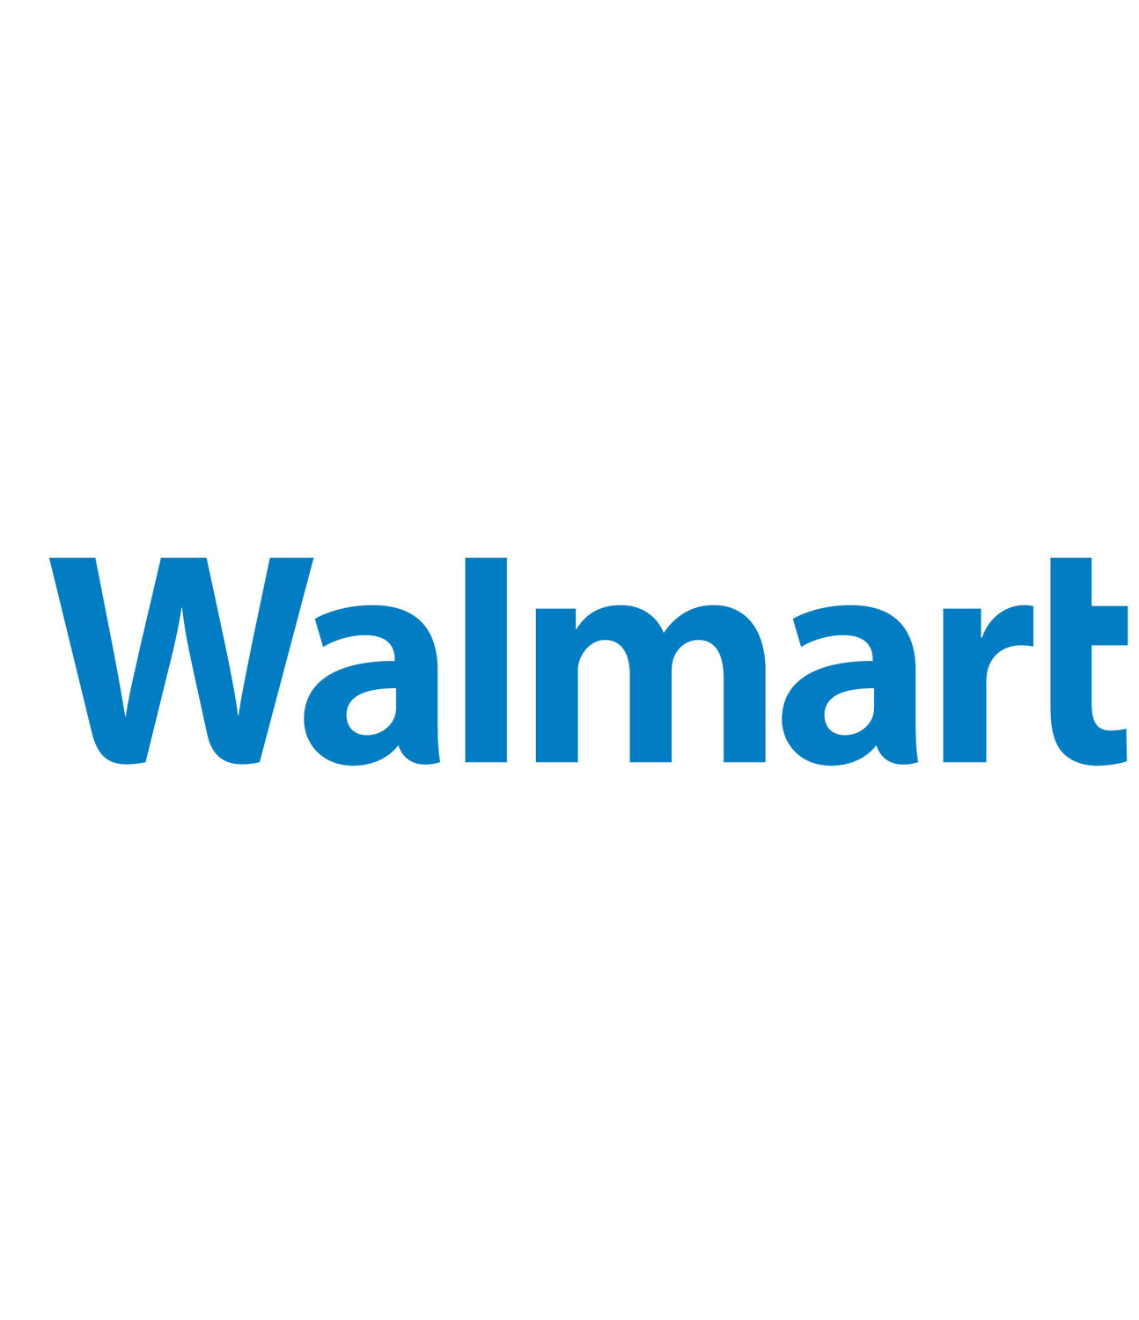
WALMART RETAIL
Group 6
Team: JJVP

Slide 2




YOUR PRESENTERS
Jonah Scott
Jean-Pierre
Valentine Jingwa Achalefi
RyeK

Slide 3

AGENDA
Organization Overview
Identifying Gaps
Evaluation Tool
Emerging Technologies
Ethical Considerations
Results / Recommendation

Slide 4
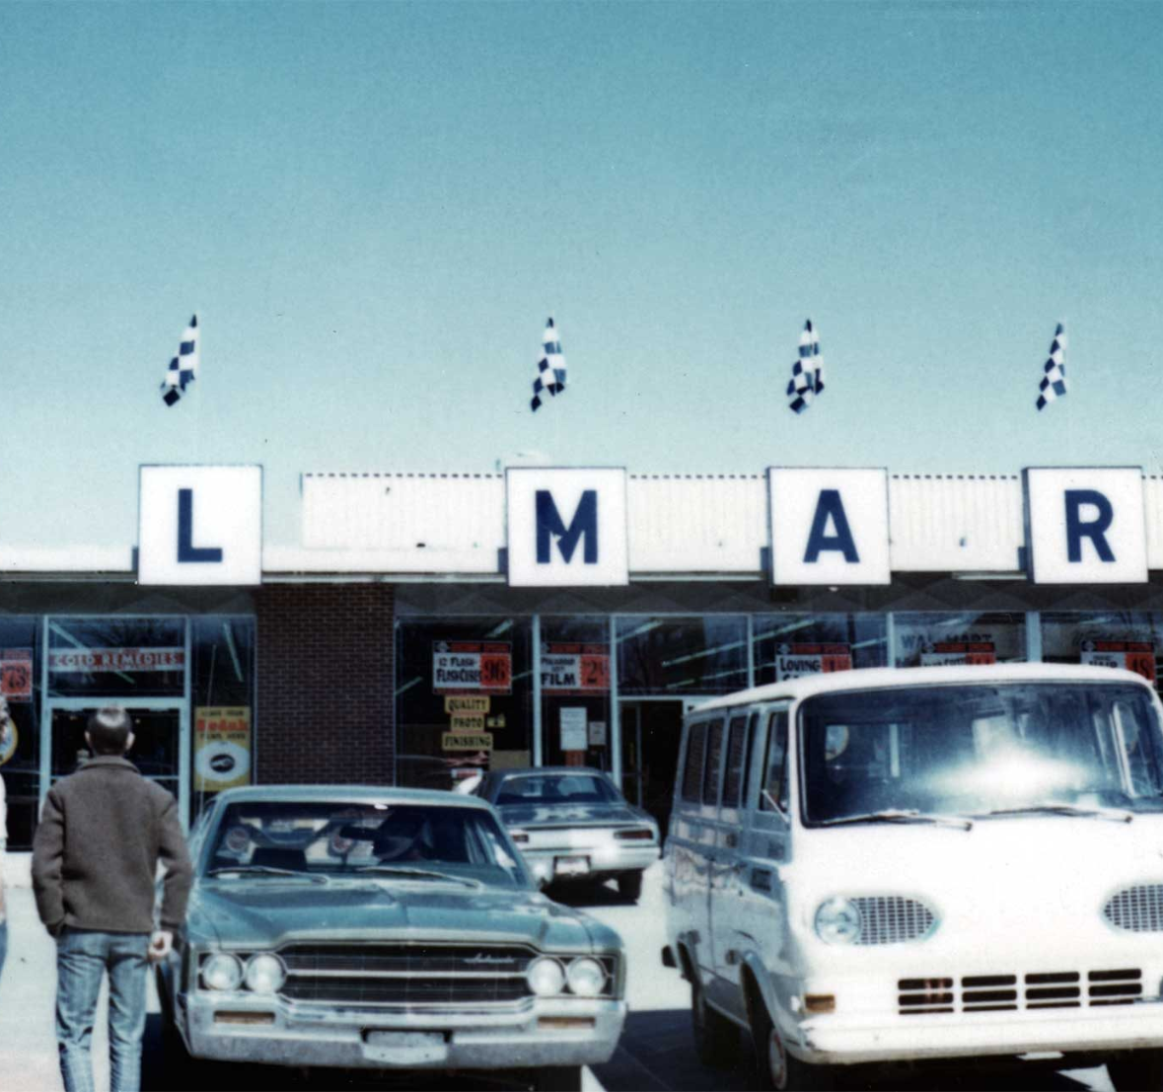
WALMART ARKANSAS 1962
Walmart was founded by ‘Sam Walton’ and was built on the idea to offer more for less.
Rogers, Arkansas, in 1962
Retail Experience from owning Ben Franklin stores
Main idea of higher sales volumes by keeping sales prices lower than his competitors
Notes:
Walmart's journey began with a single store in Rogers, Arkansas, in 1962. Founded by Sam Walton, it was built on the simple idea of offering more for less.
Walmart's journey began with a single store in Rogers, Arkansas, in 1962. Founded by Sam Walton, it was built on the simple idea of offering more for less. With relentless focus on efficiency and cost-cutting, Walmart revolutionized retail by scaling its model across the United States and then globally, becoming the world's largest retailer. As of the end of the 2020s, Walmart operates over 11,300 stores under 58 banners in 27 countries and eCommerce websites, employing over 2.2 million associates worldwide.
Throughout its history, Walmart has been a pioneer in supply chain management and technological innovation, implementing universal bar codes in the 1980s and launching one of the earliest large-scale satellite communication systems in 1987 to link all operations of the company together. Despite its physical store success, Walmart has faced challenges in the digital era, navigating the shift to online retailing and integrating its massive inventory with a seamless online customer experience.

Slide 5
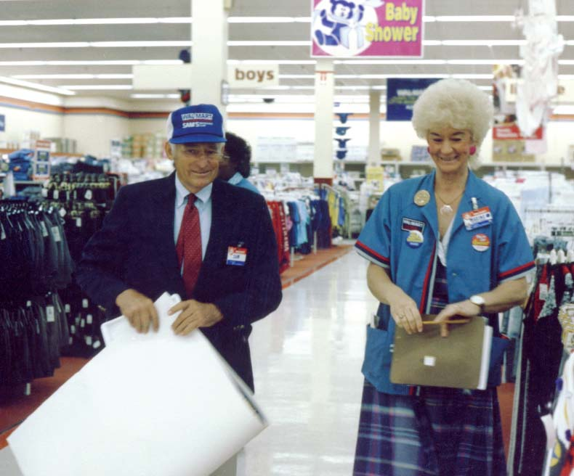
WALMART 1980S
Sam Walton
Expanded into south eastern US market.
Walmart reaches $1 billion in annual sales.
Implements the universal bar codes.
Launching a large scale satellite communication system
Notes:
Walmart has been a pioneer in supply chain management and technological innovation, implementing universal bar codes in the 1980s and launching one of the earliest large-scale satellite communication systems in 1987 to link all operations of the company together.

Slide 6
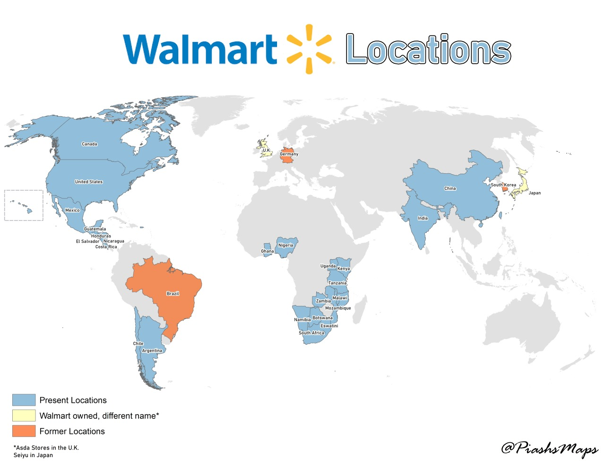
WALMART TODAY
-Retail Units 2024
11000+ stores in 27 countries
Clubs in 19 countries
1.6 million associates in the US
Online grocery and deliver service
Strong emphasis on eCommerce
Notes:
Fast Forward to the present date Walmart serves millions of customers each week internationally in its stores and online with its wide range of merchandise, including groceries, apparel, electronics, and home goods. Beyond retail, Walmart has also expanded into pharmacy services, financial services, and digital entertainment. Walmart's e-commerce operations are a critical area of focus, aiming to provide customers with convenient access to its offerings, anytime and anywhere.

Slide 7
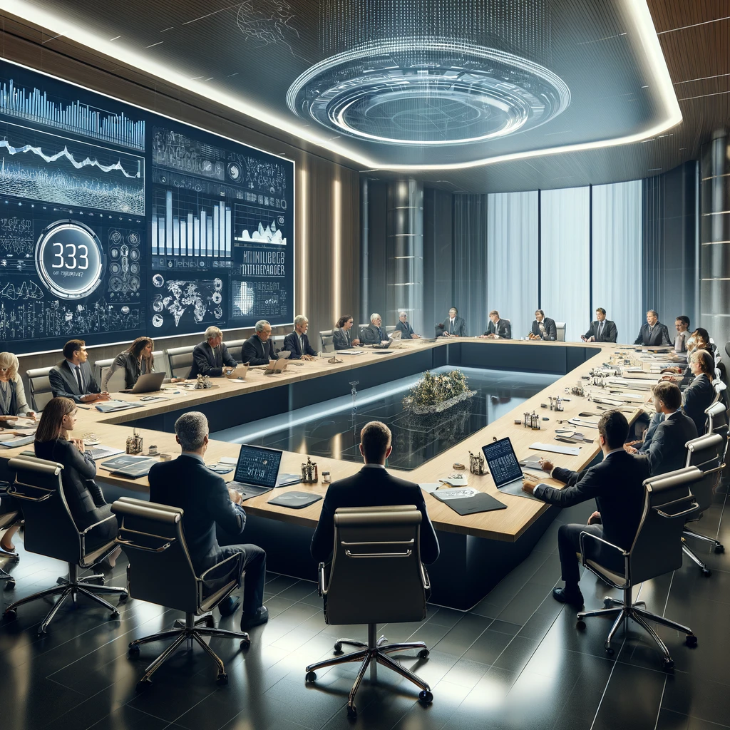
LINE OF BUSINESS
Everyone knows Walmart bruh
Wide range of merchandise (electronics, groceries, clothing, etc.)

Slide 8

CUSTOMER 1: KARENNA
“Well, I didn't think the app could get any worse, and it did. I have to sift through 3rd party sellers while trying to buy my groceries and it's super inconvenient. Yes, you can filter them out, but you have to do it for every single search. Also, there are still a lot of glitches and items are not categorized properly. I'm just trying to buy my groceries, and I don't want a $3 item from China, that costs $50 to ship.” - Walmart Customer
Notes:
Have you wondered what walmart app reviews are like when you visit playstore. Here are a few that stood out to us!

Slide 9

CUSTOMER 2: GOKU
"The app is clunky and makes shopping difficult," "Inventory is often incorrect, leading to wasted trips," and "Offers and discounts are hard to find and not personalized." - Walmart Customer

Slide 10

CUSTOMER 3
“They charged me again for the products that were out of stock. I would not recommend ordering through this app. Customer service is the worst. Go with Amazon. It's cheaper.” - Walmart Customer

Slide 11

CUSTOMER 4
“Great system but the catalogue doesn't reflect what is actually in stock. I had made up an order and was upset to see that everything I ordered on the regular was showing "out of stock". I physically went into the same store and found all the items that were listed as unavailable.” - Walmart Customer

Slide 12

THE GAPS
Customer Experience
Inventory Management

Slide 13
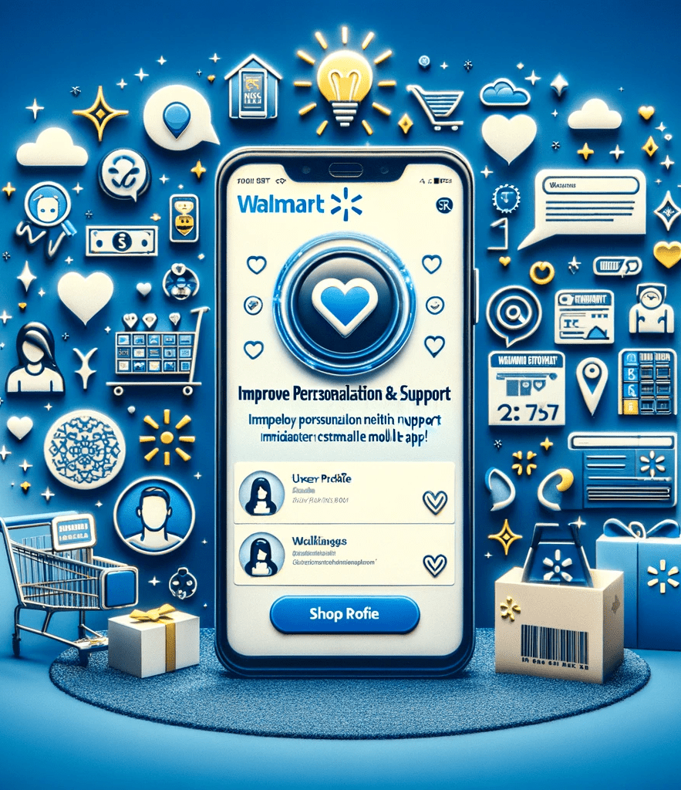
SELECTED GAP
Improving Personalization & Support
Why choose Customer Experience?

Slide 14

DISCOVERY OF GAP
Customer Surveys / Complaints
Data Analytics

Slide 15
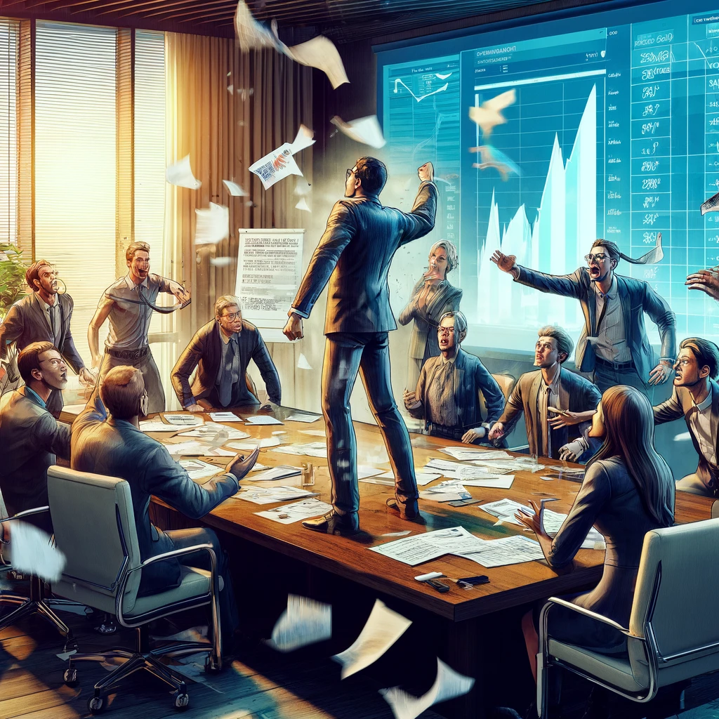
IMPACT
Company Sales
Customer Loyalty and Reputation

Slide 16
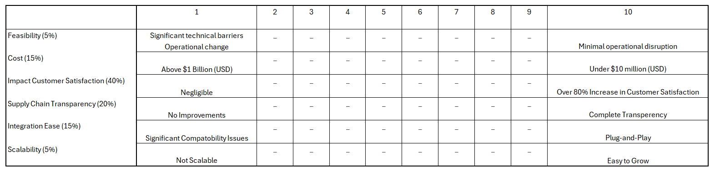
THE EVALUATION TOOL

Slide 17
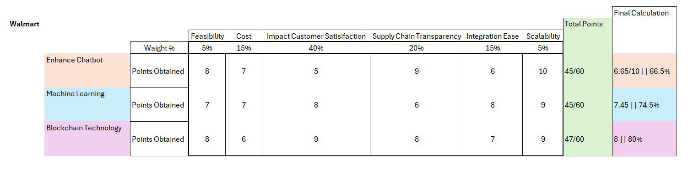
EVALUATION
Enhance Chatbot: 66.5%
Machine Learning: 74.5%
Blockchain Technology: 80%

Slide 18

DEVELOPMENT AND TESTING
Iterative Testing Process
Consumers as priority
AR (Augmented Reality)
VR (Virtual Reality)
Maps
No!

Slide 19

CONFIDENCE
High Confidence in Unbiased Results

Slide 20
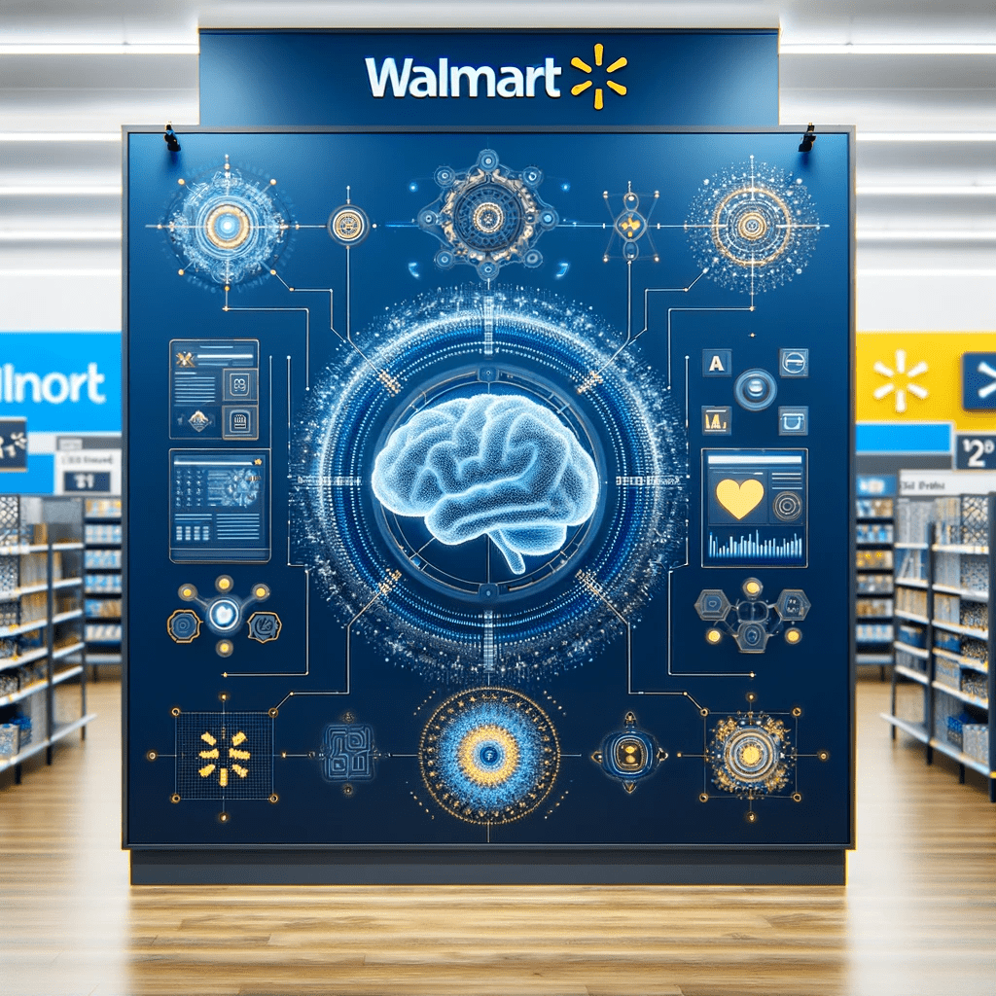
CANDIDATE EMERGING TECHNOLOGIES
Enhance Artificial Intelligence (AI) and Machine Learning.
Blockchain for Supply Chain Transparency
Robust User Interfaces/User Experience (UI/UX) Design.
Advanced Data Analysis
Chatbots and Enhanced Customer Service
Notes:
Enhance Artificial Intelligence (AI) and Machine Learning.
Blockchain for Supply Chain Transparency
Robust User Interfaces/User Experience (UI/UK) Design.
Advanced Data Analysis
Chatbots and Enhanced Customer Service

Slide 21

BLOCKCHAIN
Immutable Ledger
Real-Time Tracking and Visibility
Smart Contracts
Enhanced Security
Provenance Tracking
Reduced Costs and Efficiencies
Notes:
A blockchain is a growing list of records called blocks which are interconnected by utilizing cryptography.
Blockchain provides an immutable ledger, meaning once data is entered, it cannot be altered or deleted.
With blockchain, every transaction or movement of goods is recorded in real-time on the ledger.
Smart contracts are self-executing contracts with the terms of the agreement directly written into lines of code.
Blockchain's decentralized nature makes it highly secure against tampering and fraud. Each transaction is encrypted and linked to the previous transaction, making it extremely difficult for hackers to alter the information.
Blockchain allows for detailed provenance tracking, meaning retailers can trace the origin of each product back to its source.
By automating many supply chain processes and reducing the need for intermediaries, blockchain can significantly reduce costs associated with logistics, operations, and transactions.

Slide 22
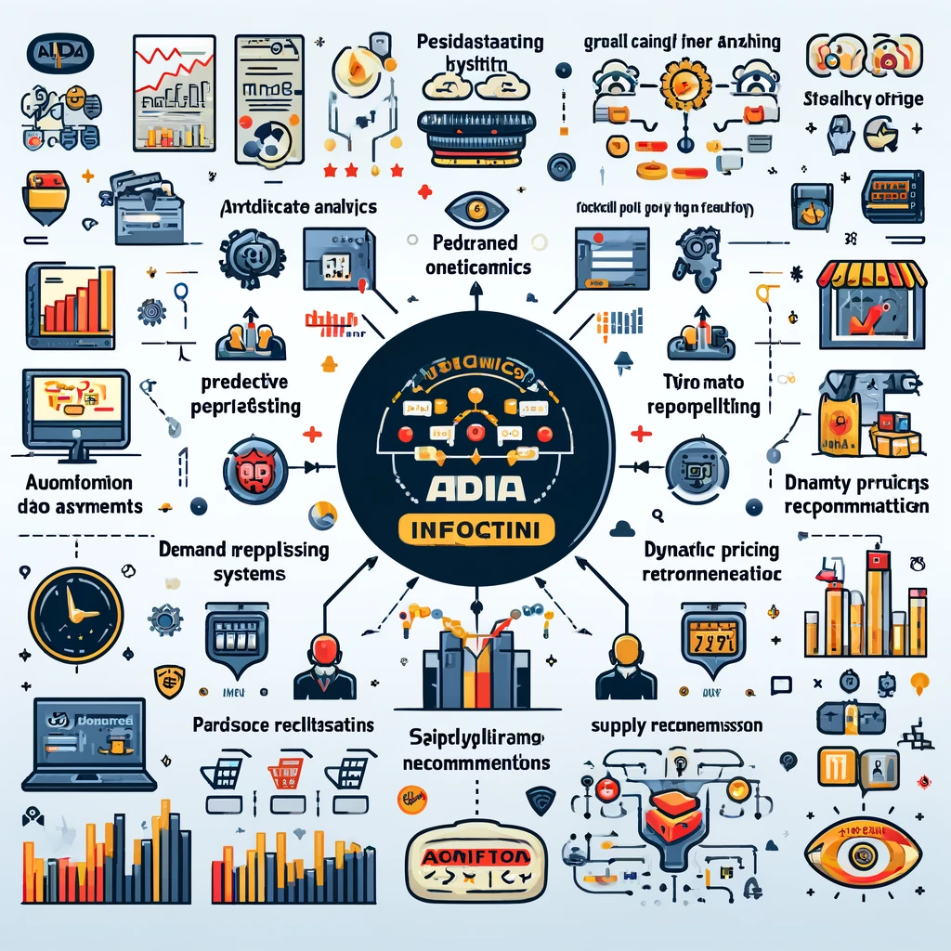
ADVANCE DATA ANALYTICS(ADA) WITH MACHINE LEARNING
Real-Time Inventory Management
Predictive Analytics for Demand Forecasting
Automated Replenishment Systems:
Identification of Stock Discrepancies
Enhanced Customer Experience
Reduced Stockouts and Overstocks
Dynamic Pricing and Promotions
Personalized Recommendations
Notes:
(ADA) represents a suite of sophisticated methodologies and technologies that analyze large and complex data sets to uncover patterns, correlations, market trends, customer preferences, and other useful business information.

Slide 23

CHATBOTS AND ENHANCED CUSTOMER SERVICE
Immediate Response Time
Scalability
Personalized Customer Experience
Cost Reduction

Slide 24

ETHICAL CONSIDERATIONS
Human Employment Impact through the use of Enhanced chatbots.
As chatbots gather personal data to function effectively, they become targets for cyber-attacks.
Blockchain can enhance transparency, it could also expose sensitive business information or customer data.

Slide 25

RESULTS
Blockchain Technology - 80%
Machine Learning - 74.5%
Enhance Chatbot - 66.5%

Slide 26

RECOMMENDATION
Enhance Chatnot
Machine Learning
Blockchain Technology

Slide 27

CONCLUSION
A combination of all three technologies will help us address all the issues hence resolving and creating a robust App.

Slide 28

EXTRA CITATIONS
Walmart History

